Slide 1
Lifestyle Impact on Sleep Health
Sadhika Varakala
Siddharth Sunkam

Slide 2
Contents
Introduction & Background
Research Question
Overview of Dataset
Methodology
Predictive Modeling Techniques
Demographic Characteristics Impact on Sleep
Physical Health Metric Analysis
Lifestyle Factors
Key Predictors of Sleep Health
Models
Visualization
Interpretation of Statistical Data
Business Impact
Conclusion

Slide 3
Introduction
Quality sleep involves more than just duration; it's a complex interplay of various factors. Wearable tech and mobile apps have expanded data collection, revealing how lifestyle, demographics, and health metrics impact sleep. This growing body of research sheds light on sleep's multifaceted nature.

Slide 4
Background
Sleep is governed by intricate biological systems influenced by external factors like light exposure and internal mechanisms such as circadian rhythms.
Categories of Influence:
Demographic Factors: Age, gender, and ethnicity influence sleep patterns and susceptibility to sleep disorders.
Physical Health Metrics: Variables like blood pressure, heart rate, and BMI are associated with sleep quality and disorders.
Lifestyle Factors: Physical activity, diet, stress, and occupation significantly impact sleep.
Environmental Influences: Light, noise, and temperature affect sleep.

Slide 5
Research Question
The study aims to analyze how lifestyle factors, physical health metrics, and demographic characteristics impact sleep health, with the goal of identifying key predictors and potential risk factors for sleep disorders.

Slide 6
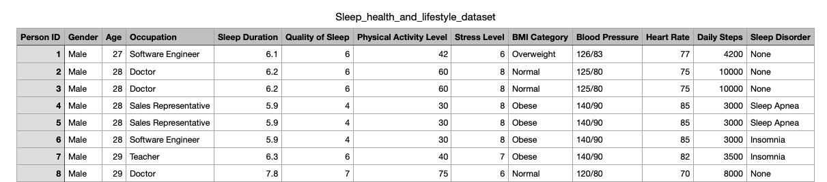
Snippet of Dataset

Slide 7
Overview of Dataset
Participant Demographics:
Gender Distribution and Age Range: Participants are aged between 27 and 59 years.
Collected Health Indicators:
Occupations: A diverse range of occupations is represented, such as Software Engineers, Doctors, and Sales Representatives.
Sleep Duration: The average sleep duration is approximately 7.13 hours, with a standard deviation of 0.80 hours.
Quality of Sleep: On a scale from 4 to 9, the average quality of sleep score is 7.31.
Physical Activity Level: Levels range from 30 to 90, with an average of 59.17, suggesting a moderately active group.

Slide 8
Overview of Dataset
Stress Level: Averages at 5.39 out of a maximum of 8, indicating a moderate level of stress across participants.
BMI Categories: Includes categories like Normal, Overweight, and Obese, affecting sleep duration and quality.
Blood Pressure and Heart Rate: Includes various readings; average heart rate is about 70 beats per minute.
Daily Steps: Participants take between 3,000 and 10,000 steps daily, averaging 6,817 steps.

Slide 9
Methodology Overview
Data Collection and Preparation
Data Imputation:
Missing data in numeric columns ('Age', 'Sleep Duration', etc.) was handled using KNN Imputation with 5 nearest neighbors to estimate missing values.
Data Encoding:
Nominal variables ('Occupation', 'Sleep Disorder') were transformed using One-Hot Encoding to facilitate their inclusion in regression models.
'Gender' was encoded as a binary variable.
'BMI Category' was converted into dummy variables.
'Blood Pressure' was split into 'Systolic BP' and 'Diastolic BP’.
Data Normalization:
Numeric columns were scaled using Standard Scaler to normalize data, which aids in model performance, especially for distance-based models and neural networks.

Slide 10
Methodology Overview
Statistical Analysis Approach
Descriptive and Inferential Statistics:
Used to summarize the data properties and to make inferences about the population.
Performed regression analysis to examine the relationship between various predictors and sleep duration.
Predictive Modeling:
Random Forest Regressor: Demonstrated high accuracy with an R^2 of 0.992 and low MSE, indicating effective prediction capability.
SVM Regressor: Showed limited performance with an R^2 of 0.206.
Neural Network Regressor: Achieved good predictive performance with an R^2 of 0.958.
Model Evaluation:
The models were evaluated based on Mean Squared Error (MSE) and R-squared (R²) to assess prediction errors and explain the variance in sleep duration, respectively.

Slide 11
Methodology Overview
Visualizations:
Coefficient Impact Chart: Visualization of the regression coefficients to highlight the impact of each factor on sleep duration. Positive coefficients indicate factors that increase sleep duration, while negative values suggest a reduction.
Model Comparison Charts: Show the MSE and R² for each model, allowing comparison of model performance in terms of error rates and explanatory power.
Results Interpretation:
The analysis shows significant predictors like 'Age', 'Physical Activity Level', and 'Stress Level' that influence sleep duration, as evidenced from the regression analysis.
Advanced machine learning models like Random Forest and Neural Networks provided strong predictive accuracy, indicating their suitability for complex pattern recognition in sleep data.
Implementation:
The Python libraries used include Pandas for data manipulation, Scikit-Learn for machine learning, and StatsModels for regression analysis.
Data visualization was supported by Matplotlib and Seaborn to produce high-quality graphs for presentation.

Slide 12
Predictive modeling techniques
Models Used
1. Random Forest Regressor:
Robust against overfitting; ideal for nonlinear data.
MSE: 0.0083, R²: 0.992 - Indicates nearly perfect predictions with minimal error.
2. SVM (Support Vector Machine) Regressor:
Suitable for regression problems, but less effective here.
MSE: 0.8376, R²: 0.206 - Shows significant prediction error and low explanatory power.
3. Neural Network Regressor (MLP):
Captures complex relationships; second-best performance.
MSE: 0.0446, R²: 0.958 - Demonstrates high accuracy with slight prediction error and explains 95.8% of the variability in sleep duration.

Slide 13
Predictive modeling techniques
Model Evaluation Metrics
MSE (Mean Squared Error) indicates the average squared difference between predicted and actual values. Lower values are better, indicating less error.
R-squared (R²) measures the proportion of variance in the dependent variable that is predictable from the independent variables. Values close to 1 indicate excellent model fit.
Summary
Random Forest provides the most accurate and reliable predictions.
SVM shows limited effectiveness in this application.
Neural Network offers a good balance, effectively capturing complex patterns in the data with high predictive accuracy and substantial explanatory power

Slide 14
Demographic Characteristics Impact on Sleep
Impact of Age
Influence: Positive
Coefficient: +1.0954
Interpretation: Each additional year in age is associated with an approximate increase in sleep duration by 1.0954 units, suggesting that older individuals tend to sleep longer.
Impact of Gender
Influence: Negative (though not statistically significant)
Coefficient: -0.1344
Interpretation: Being male is associated with a decrease in sleep duration by about 0.1344 units compared to females, although this result is not statistically significant (p-value = 0.212). This indicates that gender may have a minimal direct impact on sleep duration.

Slide 15
Demographic Characteristics Impact on Sleep
Impact of Sleep Disorders
Sleep Apnea and Insomnia
Coefficients: Insomnia (+0.8819), Sleep Apnea (+0.8344)
Interpretation: Both conditions are associated with increased sleep durations compared to no disorder, possibly due to disrupted sleep leading to longer sleep times or effective treatment regimes. Insomnia and Sleep Apnea increase sleep duration by about 0.8819 and 0.8344 units, respectively.
Summary
Age shows a significant and positive correlation with sleep duration, highlighting increased sleep needs or patterns in older adults.
Gender has a minor and non-significant effect, suggesting it might not be a critical factor in sleep duration across the population studied.
Sleep Disorders such as Insomnia and Sleep Apnea show a counterintuitive positive association with sleep duration, likely reflecting complexities in sleep quality and management rather than simply longer sleep times.

Slide 16
Physical Health Metrics Analysis
Impact of Blood Pressure
Systolic Blood Pressure
Influence: Negative
Coefficient: -0.1499
Interpretation: An increase in systolic blood pressure is associated with a decrease in sleep duration by about 0.1499 units. High systolic blood pressure could indicate stress or discomfort, which may disrupt sleep.
Diastolic Blood Pressure
Influence: Positive
Coefficient: +0.1825
Interpretation: Higher diastolic blood pressure has a positive effect on sleep duration, increasing it by about 0.1825 units. This might reflect a compensatory need for rest due to the strain of high blood pressure during waking hours.
Impact of Heart Rate
Influence: Positive
Coefficient: +0.1569
Interpretation: Each unit increase in resting heart rate is associated with an increase in sleep duration by about 0.1569 units. This suggests that individuals with higher heart rates, possibly due to stress or physical exertion, might require more sleep for recovery.

Slide 17
Physical Health Metrics Analysis
Impact of BMI
Normal and Normal Weight
Coefficients: Normal (+0.9458), Normal Weight (+0.9541)
Interpretation: Being in these healthy weight categories significantly increases sleep duration, suggesting that good weight management contributes to better sleep quality.
Obese and Overweight
Coefficients: Obese (+0.1646), Overweight (+0.4531)
Interpretation: These categories show a less pronounced impact on sleep duration. While not drastically reducing sleep duration, excess weight may still affect sleep quality and duration.
Summary
Blood Pressure: Variations in systolic and diastolic pressures show opposite effects on sleep duration, indicating the complex role of cardiovascular health in sleep.
Heart Rate: Elevated heart rates correlate with longer sleep durations, underscoring the potential restorative function of sleep.
BMI: Maintaining a normal weight is beneficial for sleep duration, while being overweight or obese has a smaller, though still positive, impact.

Slide 18
Lifestyle factors
Impact of Physical Activity
Influence: Positive
Coefficient: +0.2636
Interpretation: Higher levels of physical activity increase sleep duration by about 0.2636 units. This indicates that active lifestyles promote longer and potentially more restful sleep.
Impact of Stress Level
Influence: Negative
Coefficient: -0.3472
Interpretation: An increase in stress level decreases sleep duration by about 0.3472 units. This highlights how psychological stress can significantly cut into restorative sleep time.

Slide 19
Lifestyle factors
Impact of Occupation
Selected Examples:
1. Doctors and Engineers:
Coefficients: Doctors (+0.5662), Engineers (+0.5911)
Interpretation: These professions see increases in sleep duration by these amounts, possibly due to the regularity and demanding nature of their jobs which might necessitate more recovery time.
2. Accountants and Nurses:
Coefficients: Accountants (-0.4373), Nurses (-0.4307)
Interpretation: Face reductions in sleep duration by these amounts, which could be attributed to job stress or irregular hours that disrupt normal sleep patterns.

Slide 20
Key Predictors of Sleep Health
Major Predictors and Their Impacts
1. Age
Impact: Positive
Coefficient: +1.0954
Interpretation: Older age is associated with increased sleep duration, likely reflecting changing health and lifestyle needs with age.
2. Blood Pressure
Systolic: Negative impact (-0.1499)
Diastolic: Positive impact (+0.1825)
Interpretation: Highlights the complex role of cardiovascular health in sleep, with higher systolic pressure reducing sleep and higher diastolic pressure increasing it.
3. Physical Activity
Impact: Positive (+0.2636)
Interpretation: Greater physical activity levels are linked to longer sleep durations, emphasizing the role of active living in promoting restful sleep.

Slide 21
Key Predictors of Sleep Health
4. Stress Levels
Impact: Negative (-0.3472)
Interpretation: Higher stress levels significantly reduce sleep duration, underscoring the importance of stress management for healthy sleep patterns.
5. Occupation
Varied Impacts: Different professions show distinct influences, with some jobs like doctors and engineers associated with increased sleep, while others like accountants and nurses see decreased sleep durations.
6. Sleep Disorders
Impacts: Sleep Apnea (+0.8344), Insomnia (+0.8819)
Interpretation: Sleep disorders paradoxically show positive coefficients, indicating longer sleep durations likely due to disturbed sleep quality necessitating longer sleep times or effective treatment regimes.

Slide 22
Key Predictors of Sleep Health Summary
This comprehensive analysis identifies the key drivers of sleep health, offering insights into how various factors from different domains collectively shape sleep patterns. Understanding these relationships can help in making informed decisions about lifestyle, health management, and professional choices to enhance sleep quality.

Slide 23
Random Forest, SVM, and Neural Network Models
Model 1: Random Forest Regressor
Configuration:
Utilizes multiple decision trees to predict sleep duration, with default settings optimized for complex datasets.
Results:
MSE: 0.0083
R²: 0.992
Interpretation:
High accuracy with near-perfect explanation of variance, indicating excellent predictive reliability.

Slide 24
Random Forest, SVM, and Neural Network Models
Model 2: SVM Regressor
Configuration:
Employs a Radial Basis Function kernel, standard regularization (C=1.0), and epsilon of 0.1.
Results:
MSE: 0.8376
R²: 0.206
Interpretation:
Limited effectiveness, capturing only a small portion of the variability in sleep duration.

Slide 25
Random Forest, SVM, and Neural Network Models
Model 3: Neural Network Regressor
Configuration:
Features one hidden layer with 100 neurons, ReLU activation, and uses the Adam optimizer.
Results:
MSE: 0.0446
R²: 0.958
Interpretation:
Strong predictive capability, explaining a significant amount of variance with minor prediction errors.

Slide 26
Model Comparisons - MSE and R² Scores
MSE Scores
Random Forest: 0.0083
SVM: 0.8376
Neural Network: 0.0446
Interpretation: Lower MSE scores indicate better model performance with less error in predictions. The Random Forest model exhibits the least error, followed by the Neural Network, while the SVM shows significantly higher error rates.
R² Scores
Random Forest: 0.992
SVM: 0.206
Neural Network: 0.958
Interpretation: Higher R² values signify a model's ability to explain more variability in the dependent variable. The Random Forest model performs exceptionally well, nearly explaining all variability, with the Neural Network also showing high performance. The SVM, however, explains a relatively small portion of the variability.

Slide 27
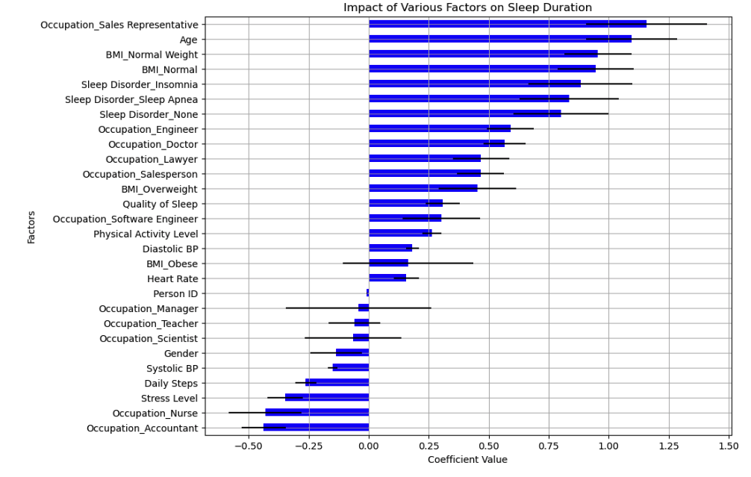
Visualization of Model Performances
Impact of Various Factors on Sleep Duration
This bar chart shows the estimated coefficients for each predictor variable from the OLS regression model. The length of the bar represents the size of the coefficient, and the horizontal lines represent the standard errors, indicating the confidence in the estimate.
Positive Coefficients: Factors like "Age" and "BMI Normal" suggest longer sleep duration.
Negative Coefficients: "Stress Level" and "Occupation_Accountant" indicate shorter sleep duration.
Error Bars: Show confidence range; smaller bars mean more precise estimates.

Slide 28
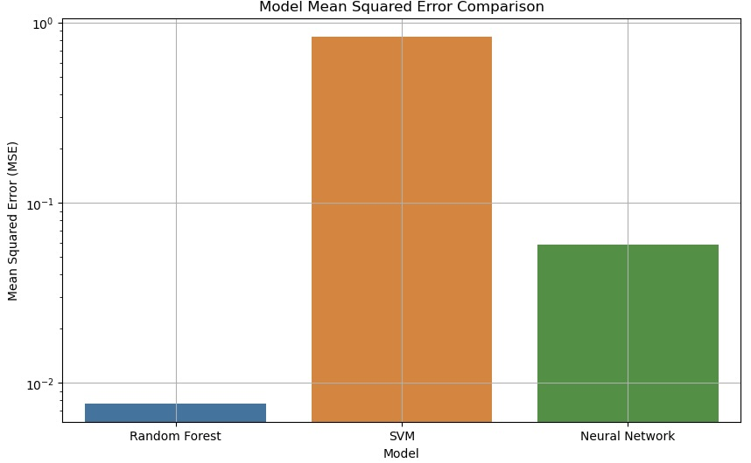
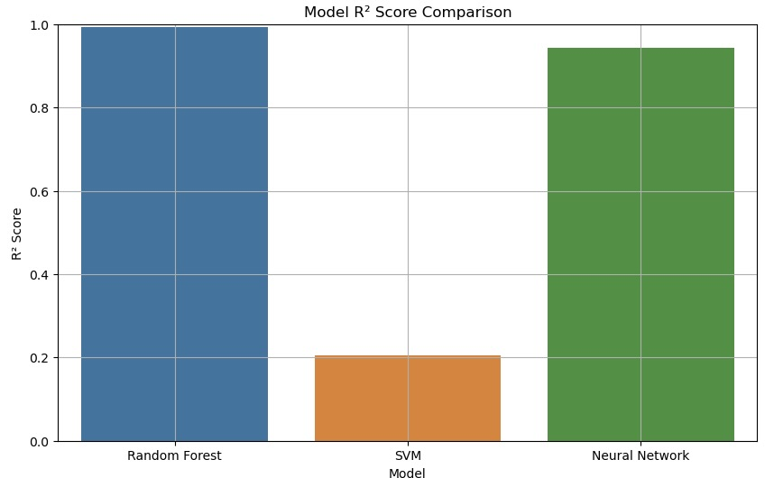
Visualization of Model Performances
Model Mean Squared Error and R² Score Comparison
The first plot (top) compares the Mean Squared Error (MSE) of the three models. The second plot (bottom) compares the R² score.
•⁠ ⁠MSE Plot: Displays on a logarithmic scale the MSE for each model, which measures the average squared difference between the estimated values and the actual value. A lower MSE indicates a better fit. The Random Forest model has the lowest MSE, suggesting it predicts sleep duration with the least error.
•⁠ ⁠R² Plot: Shows the proportion of variance for sleep duration that's explained by the models. R² values range from 0 to 1, with higher values indicating a better fit. The Random Forest and Neural Network have high R² scores, showing they explain most of the variability in sleep duration, while SVM has a lower score.

Slide 29
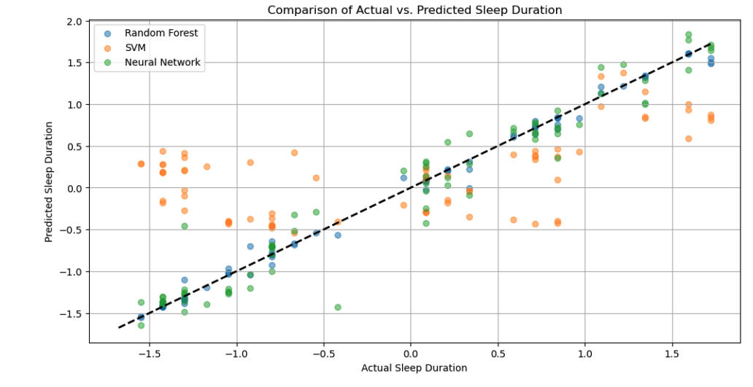
Visualization of Model Performances
Comparison of Actual vs. Predicted Sleep Duration
This scatter plot compares the actual sleep durations (on the x-axis) against the predicted sleep durations (on the y-axis) for each model.
•⁠ ⁠Data Points: Each dot represents an observation from the test set. The closer a dot is to the dashed line, the more accurate the prediction.
•⁠ ⁠Fit Quality: If the points form a tight cluster around the dashed line (y=x), it indicates good model predictions. The Random Forest and Neural Network appear to have clusters close to the line, indicating good performance.
•⁠ Outliers: Points that are far from the line represent instances where the model predictions were quite inaccurate.

Slide 30
Understanding Units in Context
1.⁠ ⁠Dependent Variable (Sleep Duration):
The units of "Sleep Duration" depend on how it is measured in the dataset. Commonly, sleep duration might be recorded in hours or minutes. For instance, if sleep duration is measured in hours, a coefficient of 1.0954 for age would imply that each additional year of age is associated with an increase of approximately 1.0954 hours in sleep duration.
2.⁠ ⁠Independent Variables:
Age: Typically measured in years. A one-year increase in age is associated with changes in sleep duration as indicated by the coefficients.
Blood Pressure: Measured in mmHg (millimeters of mercury). The coefficients for systolic and diastolic blood pressure indicate how changes in blood pressure by one mmHg affect sleep duration.
Heart Rate: Usually measured in beats per minute (bpm). The coefficient indicates the change in sleep duration for each one bpm increase in heart rate.
BMI (Body Mass Index): A numerical value calculated from weight and height. The coefficients for each BMI category indicate the change in sleep duration associated with being in these categories compared to the base category (often the omitted category in regression models).

Slide 31
Understanding Units in Context
Examples with Units:
Age: A coefficient of 1.0954 implies that each additional year of age is associated with an increase in sleep duration of about 1.0954 hours (assuming sleep duration is measured in hours).
Systolic Blood Pressure: A coefficient of -0.1499 means that for every increase of 1 mmHg in systolic blood pressure, sleep duration decreases by 0.1499 hours.
Diastolic Blood Pressure: A coefficient of 0.1825 indicates that for each 1 mmHg increase in diastolic blood pressure, sleep duration increases by 0.1825 hours.
Physical Activity Level: If this is measured on a scale (e.g., 1 to 10), a coefficient of 0.2636 would suggest that moving up one level on the activity scale is associated with an increase of 0.2636 hours in sleep duration.

Slide 32
Interpretation of Statistical Data Key Coefficients and Their Interpretations
Age:
Coefficient: +1.0954
P-Value: <0.001
Interpretation: Statistically significant; suggests that older individuals tend to sleep longer, possibly due to changing health or lifestyle.
Gender (Male):
Coefficient: -0.1344
P-Value: 0.212
Interpretation: Not statistically significant; indicates minimal impact of gender on sleep duration.
Physical Activity Level:
Coefficient: +0.2636
P-Value: <0.001
Interpretation: Statistically significant; higher physical activity is associated with longer sleep, likely due to greater bodily recovery needs.
Stress Level:
Coefficient: -0.3472
P-Value: <0.001
Interpretation: Statistically significant; higher stress levels reduce sleep duration, reflecting the adverse effects of stress on sleep.

Slide 33
Interpretation of Statistical Data Key Coefficients and Their Interpretations
Occupations (select examples):
1. Doctors: +0.5662
2. Engineers: +0.5911
3. Accountants: -0.4373
4. Nurses: -0.4307
P-Values: <0.05 for all listed
Interpretation: All are statistically significant; job roles influence sleep duration variably, with some professions linked to longer sleep and others to shorter.
Sleep Disorders (Insomnia, Sleep Apnea):
Coefficients: Insomnia (+0.8819), Sleep Apnea (+0.8344)
P-Values: <0.001 for both
Interpretation: Statistically significant; both conditions are associated with longer reported sleep durations, possibly due to the nature of the disorders or their treatments.

Slide 34
Interpretation of Statistical Data Summary
This detailed examination of coefficients reveals how each variable quantitatively impacts sleep duration and its level of significance. Such insights are crucial for developing targeted interventions or recommendations aimed at improving sleep quality based on empirical evidence.

Slide 35
Business Implications
Applications in Healthcare
Personalized Treatment Plans: Customize treatments based on key predictors like age, stress levels, and sleep disorders to enhance sleep quality.
Preventive Health Programs: Develop programs promoting stress management and physical activity, targeting specific demographic groups to prevent sleep-related issues.
Applications in Wellness Industry
Product Development: Create wellness products like wearable devices that adjust recommendations for sleep based on user-specific data on activity levels or stress.
Health and Wellness Apps: Develop apps that provide personalized advice on sleep habits and relaxation techniques based on daily data inputs from users.
Summary
These insights enable the healthcare and wellness industries to tailor their offerings more effectively, improving sleep health through personalized, data-driven solutions.

Slide 36
Conclusion - Summary of Findings
Key Predictors: Age, stress levels, physical activity, and specific occupations significantly influence sleep duration.
Health Metrics: Blood pressure and BMI categories show distinct impacts on sleep, with systolic pressure decreasing sleep duration and higher diastolic pressure increasing it.
Sleep Disorders: Conditions like insomnia and sleep apnea are associated with longer sleep durations due to the nature of the disorders affecting sleep quality.
Model Performance: The Random Forest model proved to be the most effective in predicting sleep duration, with high accuracy and reliability.

Slide 37
Conclusion - Recommendations
Healthcare Providers:
Develop personalized sleep management plans that consider the patient's age, occupation, and stress profile.
Implement screening and intervention programs focusing on physical activity and stress management to improve sleep health.
Policy Makers:
Encourage workplace policies that reduce stress and promote physical wellness, potentially including flexible work hours or wellness program incentives.
Support public health campaigns that educate on the importance of managing blood pressure and maintaining a healthy weight for better sleep.
Research and Development:
Continue to refine predictive models using machine learning to enhance accuracy and provide more personalized health recommendations.
Explore the development of new wearable technology that can monitor and provide feedback on sleep-related health metrics in real-time.

Slide 38
Conclusion
Final Thoughts
This research highlights the complex interplay of various factors affecting sleep and underscores the potential of data-driven approaches in enhancing sleep quality. Moving forward, leveraging these insights can lead to better health outcomes and more effective management of sleep disorders.

